Slide 1
Virtualization: Docker
With Mike Iversen

Slide 2

What is virtualization?
Notes:
The process of emulating a thing in another thing.

Slide 3
What is virtualization
Virtual Machines
Virtualizes the entire hardware stack (mostly)
Useful for specialized testing or for long running “servers”
Great for load sharing
Containers
Virtualizes nothing (technically)
Useful for generic testing and development
Great for reproducible builds

Slide 4
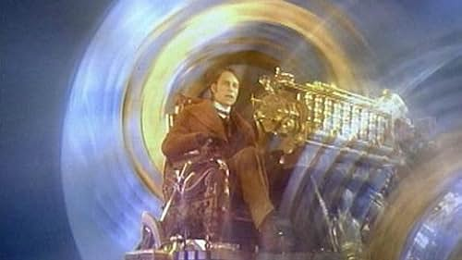
Source: https://www.youtube.com/watch?v=-XMaEfJOGJg
Notes:
The year was 1968 and work was just being finished on a first attempt at a Time-sharing operating system

Slide 5
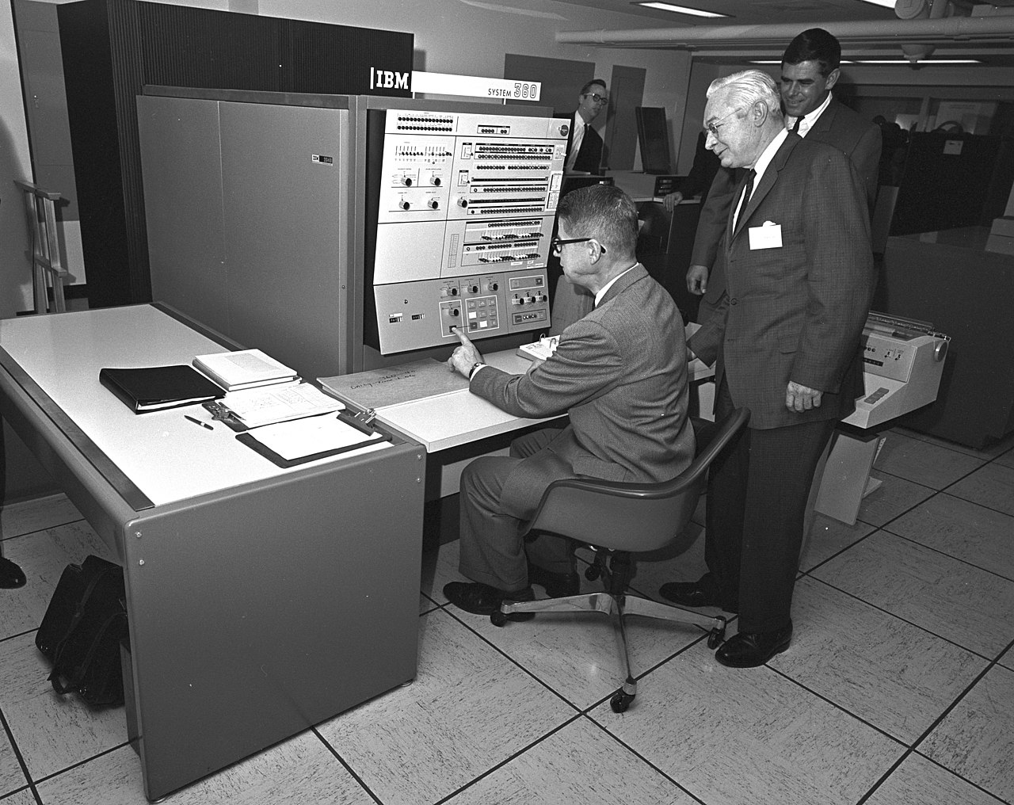
Notes:
1968 saw the release of the IBM CP-40, the world’s first time sharing machine.

Slide 6
If you’re a nerd…
History of Virtualization Development: https://en.wikipedia.org/wiki/Timeline_of_virtualization_development
Notes:
NERD

Slide 7
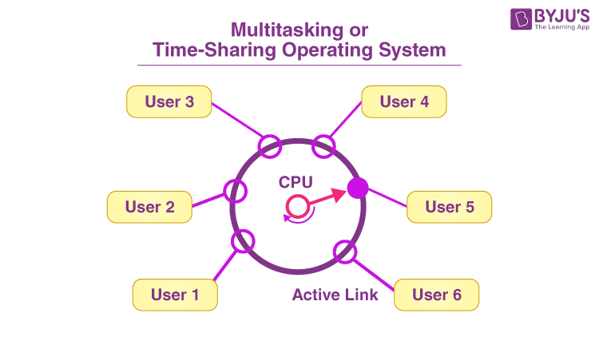
Time Shared Operating System
Source: https://byjus.com/gate/time-sharing-operating-system-notes/
Notes:
Time sharing, or scheduling (as we are more familiar with today) is the process of managing multiple processes all attempting to use the same hardware resources.
In the late 60s, this was a single CPU executing a single set of instructions at a time, though today it is multiple CPUs executing multiple pieces of instructions at the same time (while keeping results in sync for the eventual return to DBUS)

Slide 8
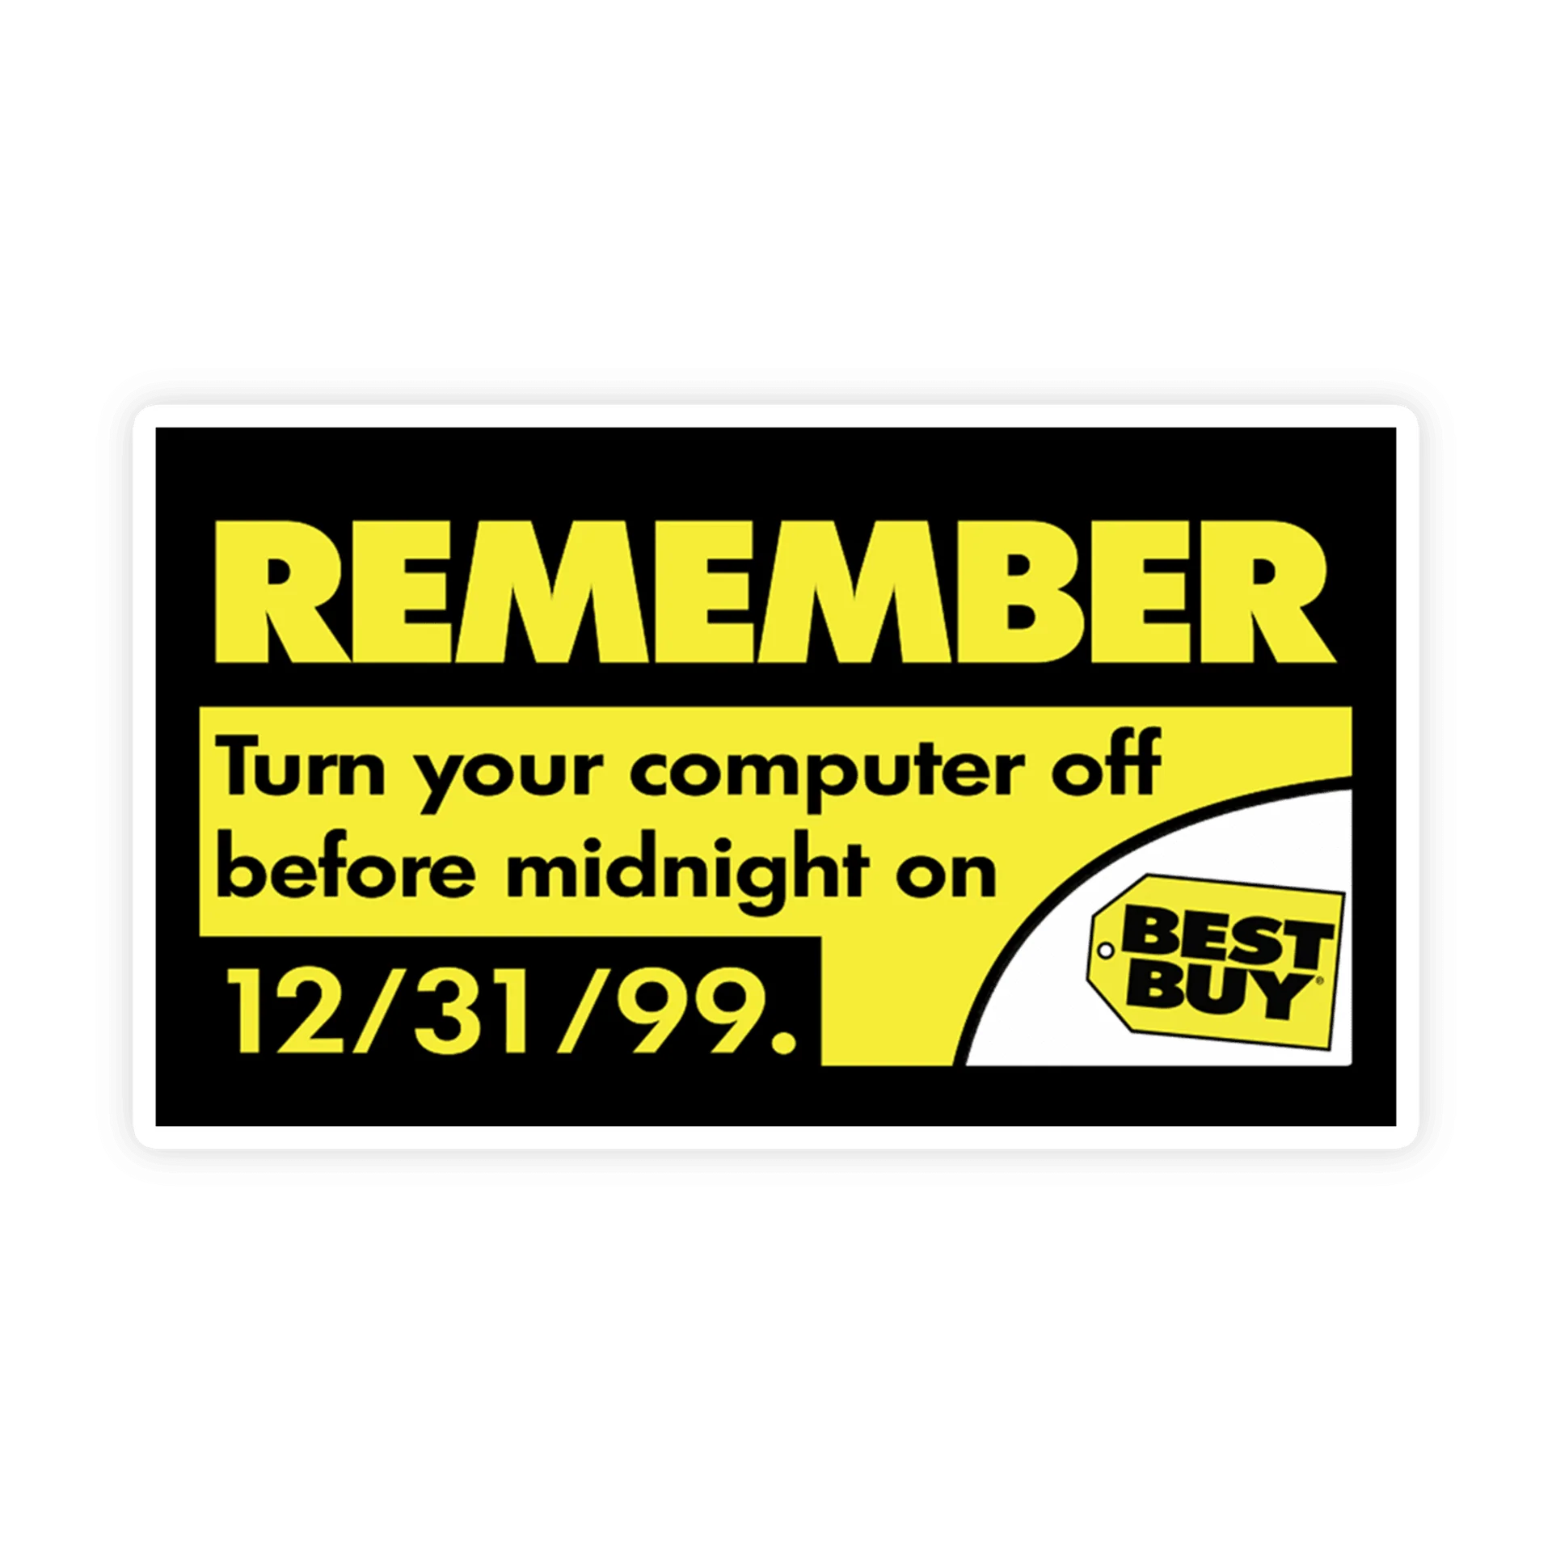
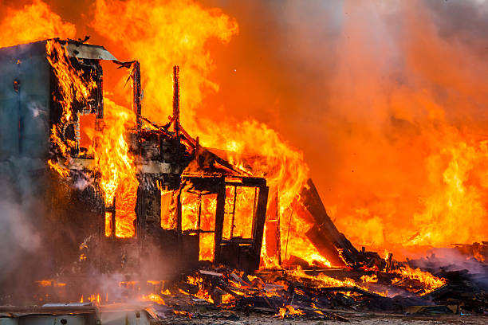
Notes:
Jump forward to late 90s when the world was ending. Talk about FreeBSD Jails

Slide 9
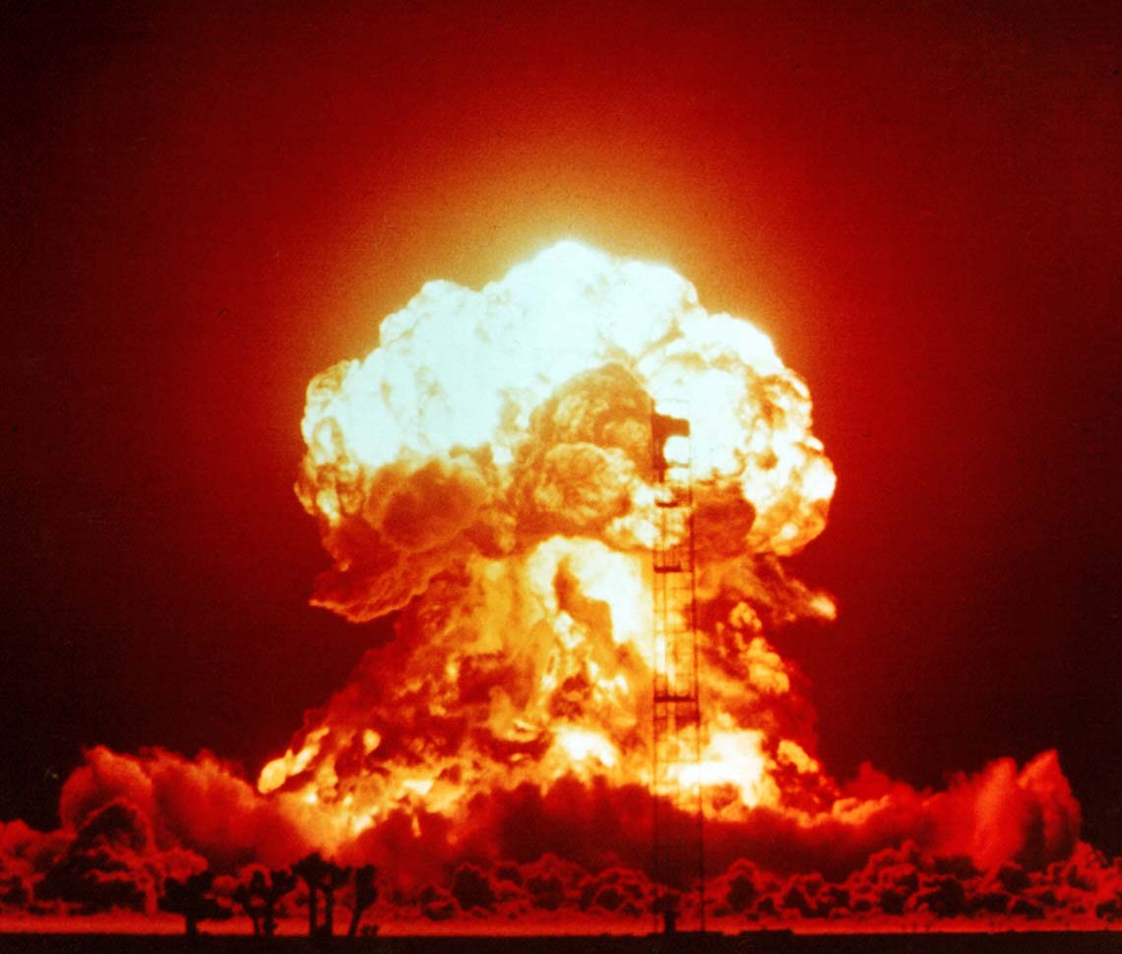
Notes:
Jump forward to late 90s when the world was ending. Talk about FreeBSD Jails

Slide 10
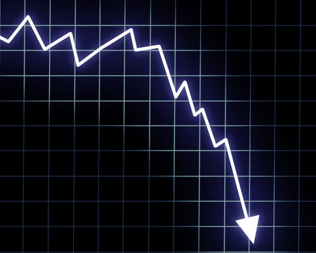
Notes:
Jump forward to late 90s when the world was ending. Talk about FreeBSD Jails

Slide 11
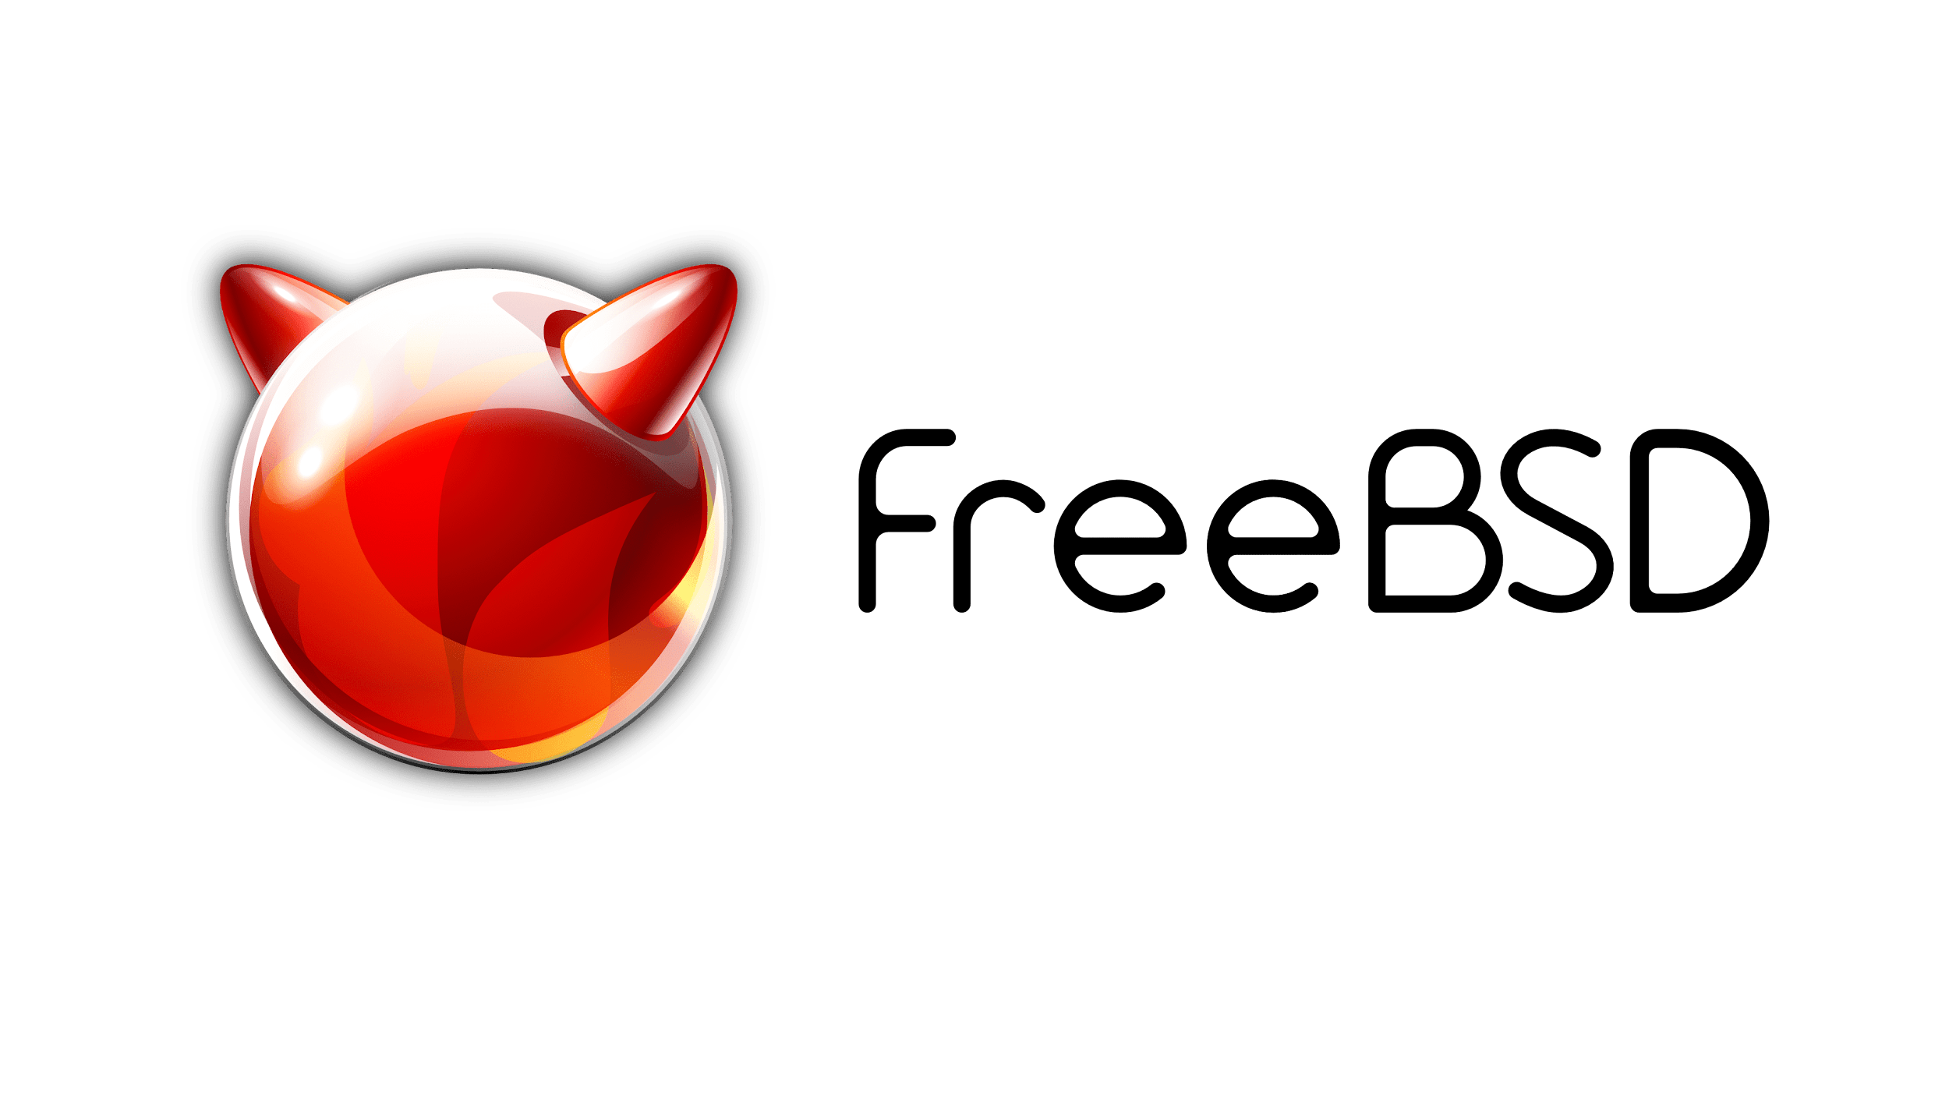

Slide 12
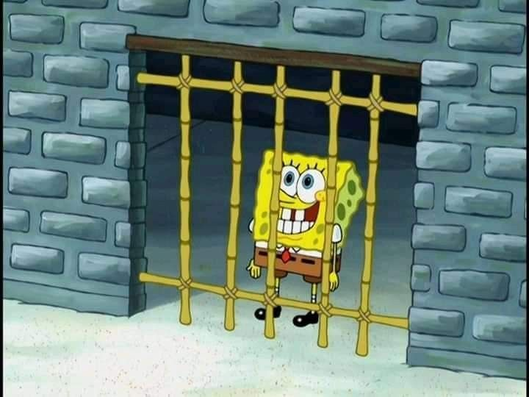
Source: https://en.wikipedia.org/wiki/FreeBSD_jail

Slide 13
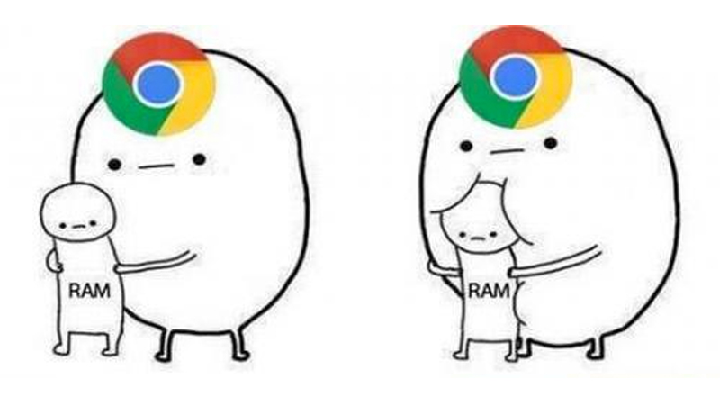
Notes:
Talk about how VMs are resource hogs compared to jailed processes

Slide 14
Differences between Jails and Containers
Jails
Segment the process in a different part of the filesystem
Containers
Segment the process in a different part of the filesystem
Segment network traffic via “Iptables shenanigans”
Don’t save filesystem changes
Notes:
Jails are built upon “chrooting” or “changing the root directory for a process”

Slide 15
Why do we virtualize?

Slide 16
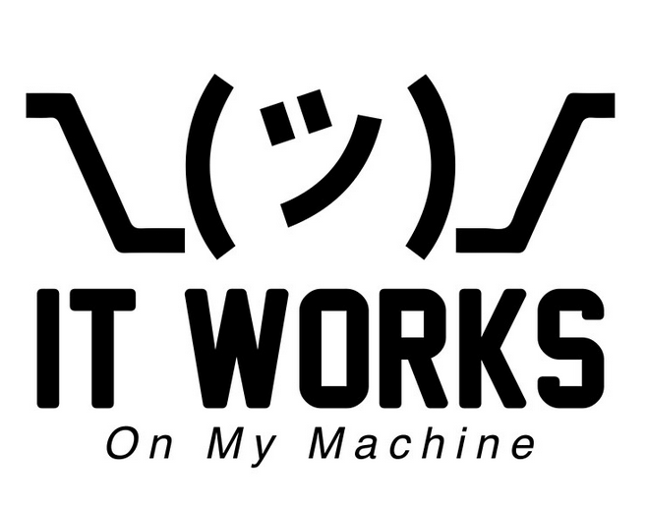

Slide 17

Notes:
Your containers will work the same on a super computer

Slide 18
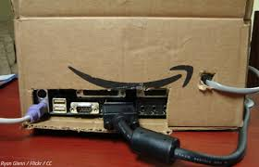
Notes:
As they do on your shitty raspberry pi

Slide 19
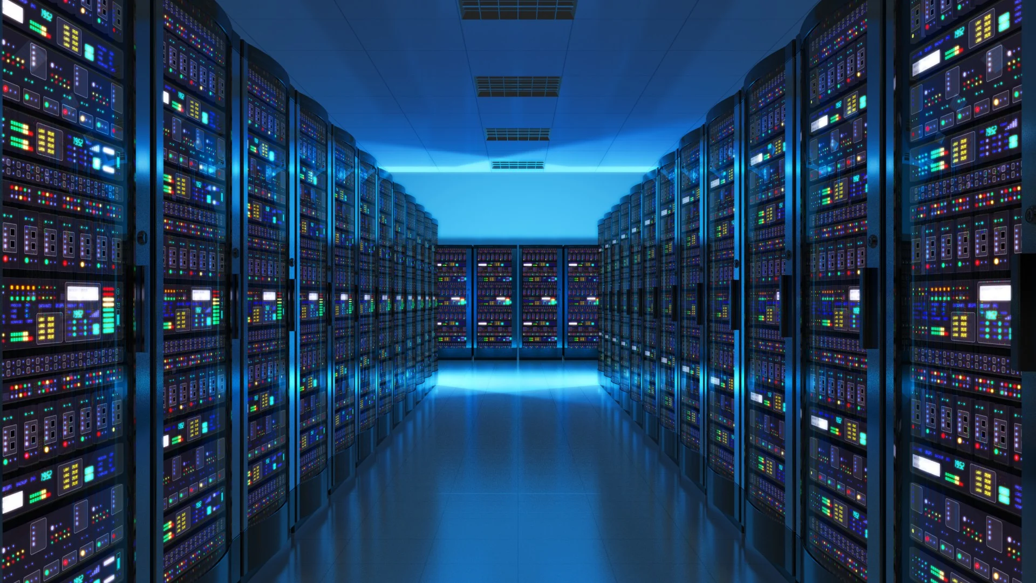
Notes:
Virtualizing allows server’s to make full use of their available resources

Slide 20
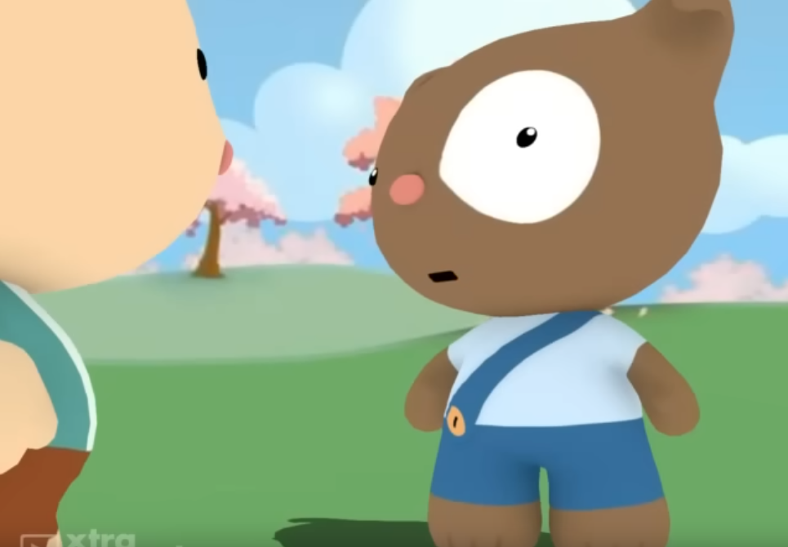
Video Source: https://www.youtube.com/watch?v=b2F-DItXtZs
Notes:
SCALE

Slide 21

Notes:
SCALE == line go == equal money… Or something.

Slide 22
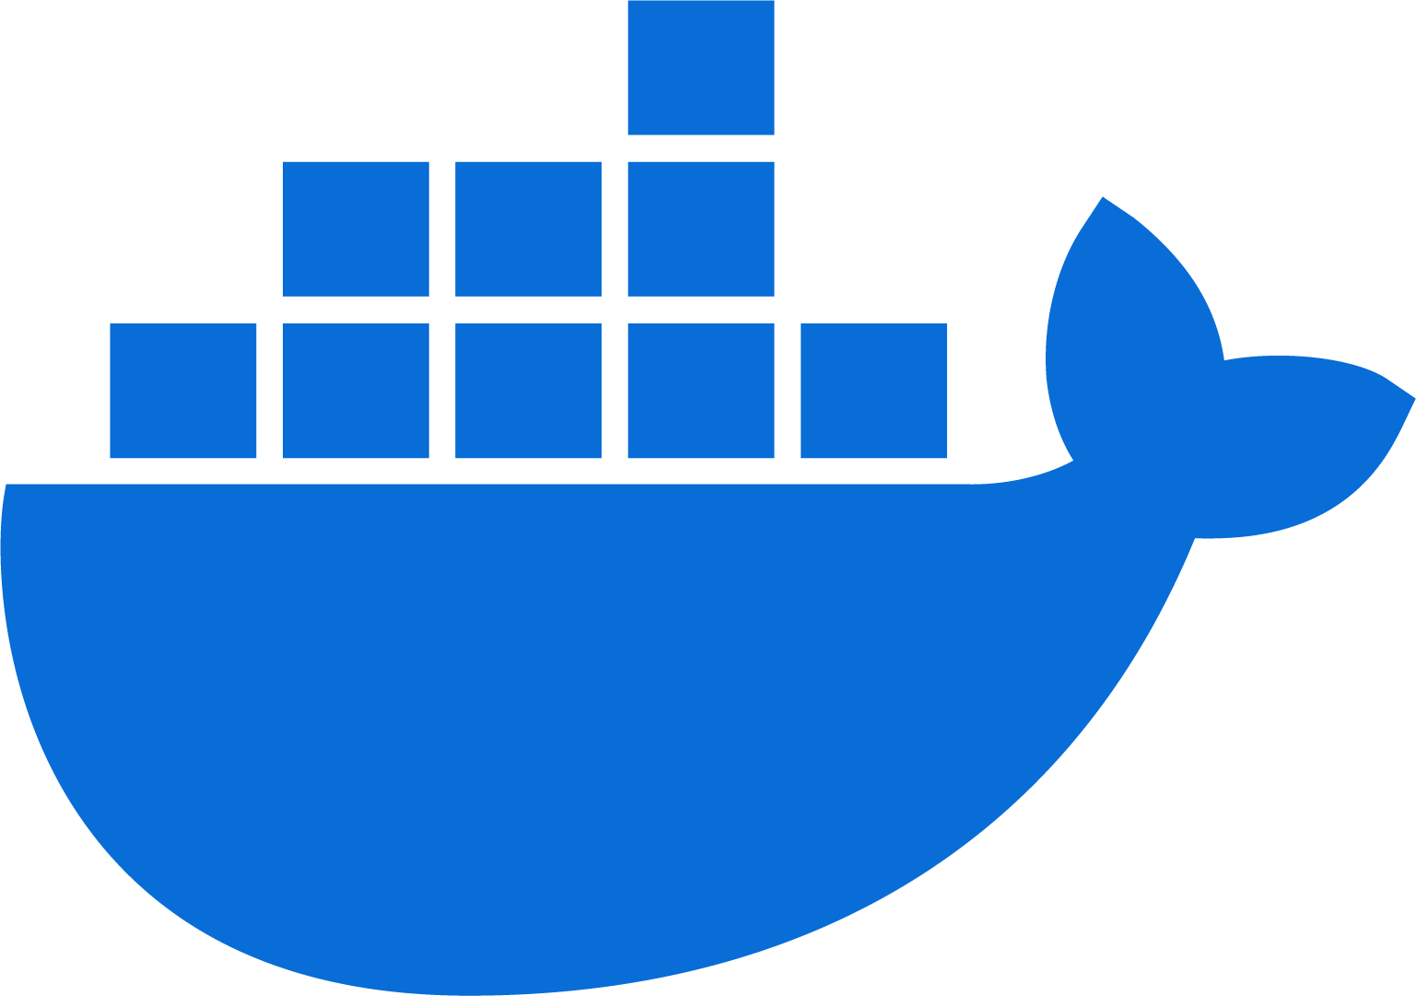
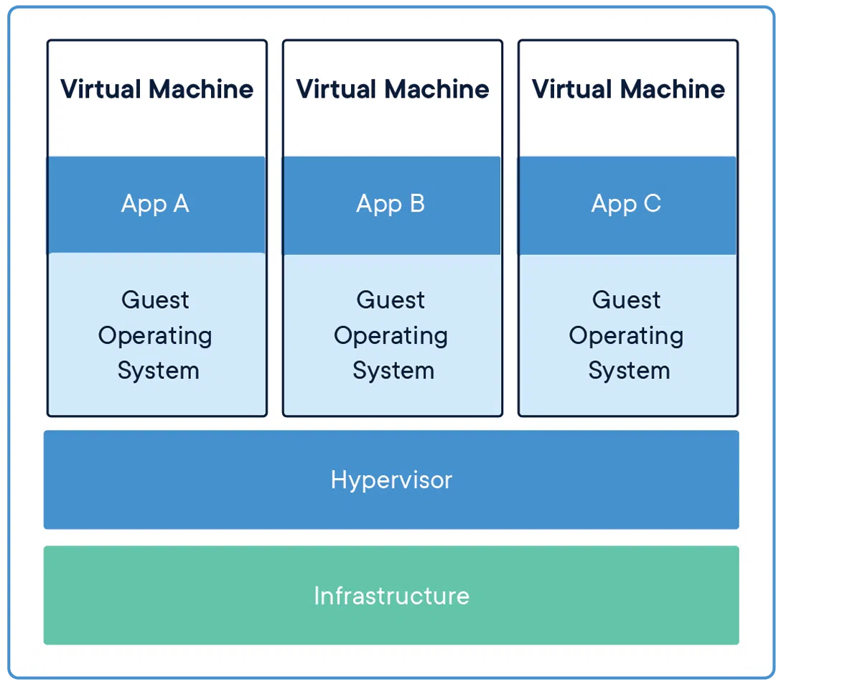
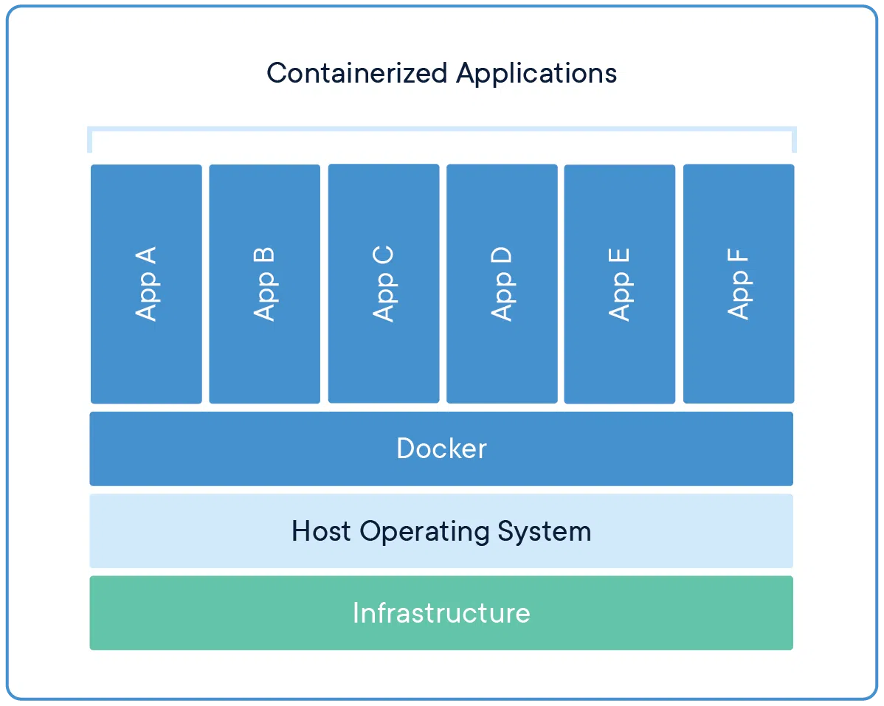
Let’s Talk Docker
Image Source: https://www.cherryservers.com/blog/a-complete-overview-of-docker-architecture
Notes:
Docker is a platform/standardization for containers. They created the standard for container images which is now used by the OCI (Open Container Initiative) and is used by Podman, LXC, and Docker for standard container building across products.

Slide 23
Why is Docker?
You can…
Explore new applications
Explore new languages
Home Assistant
https://hub.docker.com/r/homeassistant/amd64-addon-mosquitto
Plex
https://hub.docker.com/r/linuxserver/plex
Nextcloud
https://hub.docker.com/_/nextcloud
Gitlab
https://docs.gitlab.com/ee/install/docker.html
Javascript
https://hub.docker.com/_/node
Perl
https://hub.docker.com/_/perl
Python
https://hub.docker.com/_/python
Haskell
https://hub.docker.com/_/haskell

Slide 24
Why is Docker?
You can do shenanigans like…
Drastically decrease rust binary compilation times
https://github.com/LukeMathWalker/cargo-chef
Create devops “pipelines” to increase product stability
https://docs.github.com/en/actions/using-jobs/running-jobs-in-a-container
Easily scale applications horizontally instead of vertically
https://kubernetes.io/

Slide 25
Let’s really talk Docker
Important Keywords
Important Commands
FROM
COPY
RUN
CMD
ENTRYPOINT
docker ps
docker run
docker stop
docker rm
Notes:
After this, we should show some of the previous docker images we talked about and how easy it is to get up and running with something in docker

Slide 26
Let’s really talk Docker
Docker Compose

Slide 27
Resources
Docker Hub: https://hub.docker.com
Github Link: https://github.com/miversen33/docker-tut

